Slide 1


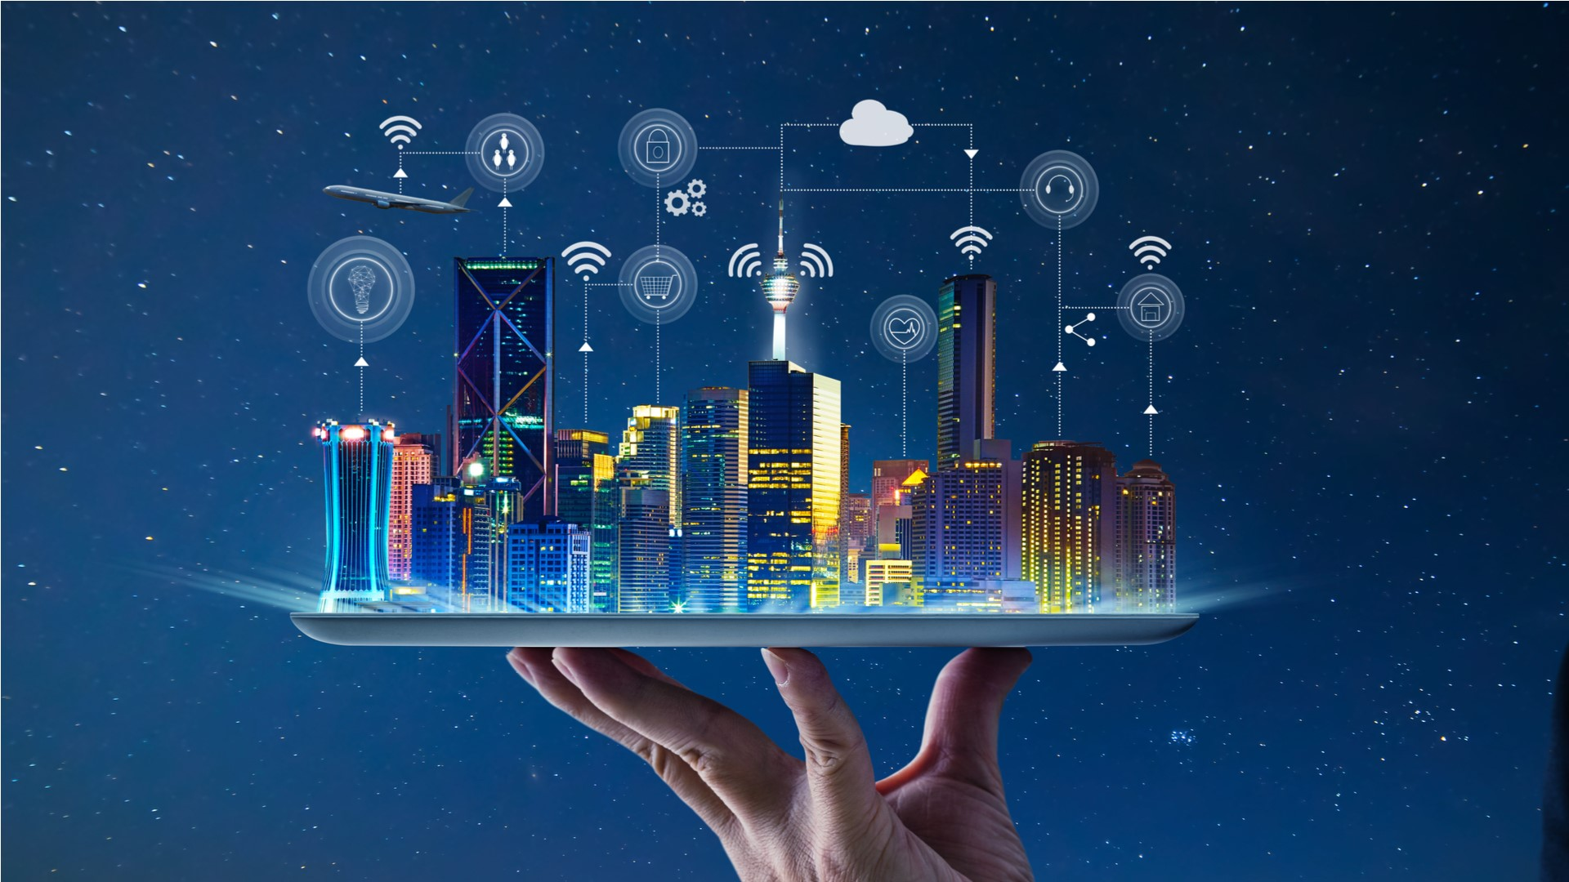
IOT PROJECT
IRRIGAZIONE
PIANTA

Slide 2
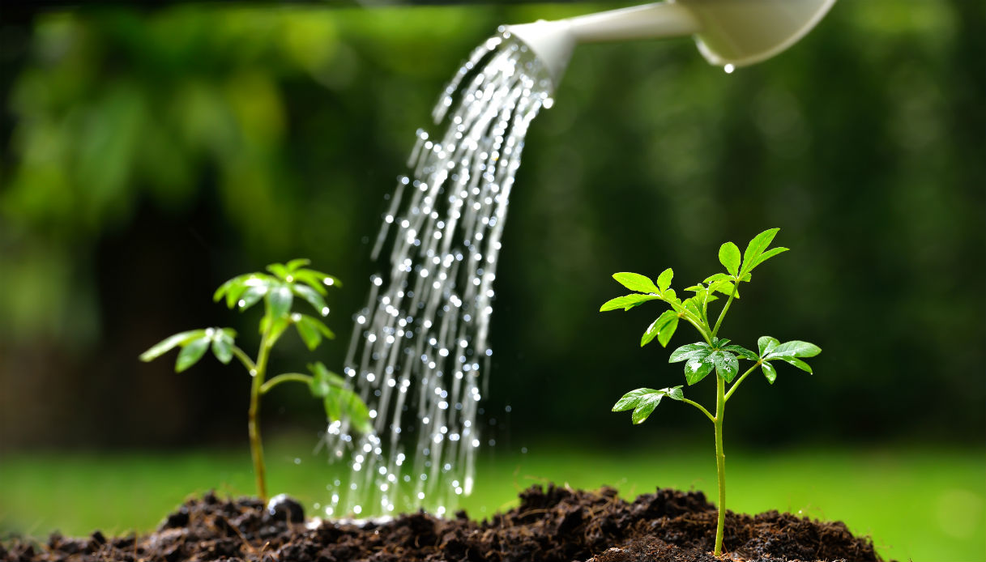
WHY IS WATERING PLANTS SO IMPORTANT?
Because plants provide the basic oxygen to our existence and are an essential part of the food chain, as well as a source of sustenance for the species of the planet.
For this reason it is important to provide water to plants, which performs many functions within them, provides nutrients and is an integral part of the lymphatic system.
The idea is the implementation of an automatic irrigation system for plants. This system allows you to track the condition of the plant and irrigate at any time the user wishes.

Slide 3

USED TOOLS
Zerynth Studio: is a powerful IDE for embedded programming.
Python: is a more "high-level" programming language than most other object-oriented languages for developing distributed applications, scripting, numerical computation and system testing.
ESP32 devkit v1,devkit c: is a series of low-cost, low-power system on a chip microcontrollers with integrated Wi-Fi and dual-mode Bluetooth.
ZDM: a device and data management service.
Grafana: a web application for interactive data visualization and analysis.
Devices: Several devices will be used, such as HTU21D, DS1307, HC-SR04, Water Level Sensor, Relay Module, Power Supply Module, Water Pump, Led and an LCD display.

Slide 4

IMPLEMENTATION IDEA
The idea was to use the humidity/temperature sensor to capture information from the plants, so as to irrigate according to the information received. In addition, through the Real Time Clock Module, we want to keep track of the time spent in order to irrigate the plant cyclically, even if the weather conditions are good, to avoid dehydration. Irrigation will be carried out through a water pump fed with 5 volts through a relay module. Service information will then be shown on video via the 16x2 LCD Display, also based on I2C. It will also be given the possibility to the user to send, through the Zerynth Device Manager (ZDM), irrigation commands at any time, regardless of the weather conditions or the time elapsed.

Slide 5
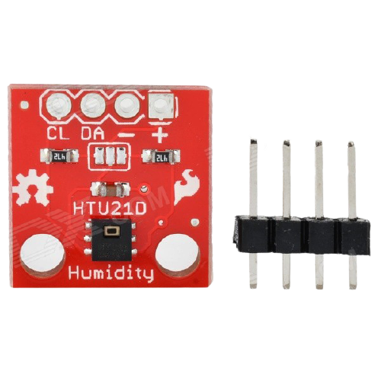
HTU21D
HTU21D is a humidity and temperature sensor.
The sensor has 4 pins: 3.3 for power supply; Gnd for mass; SDA: I2C Serial Data; SCL: I2C Serial Clock.
The sensor allows you to derive the value of temperature and humidity detected in real-time in the surrounding environment.

Slide 6
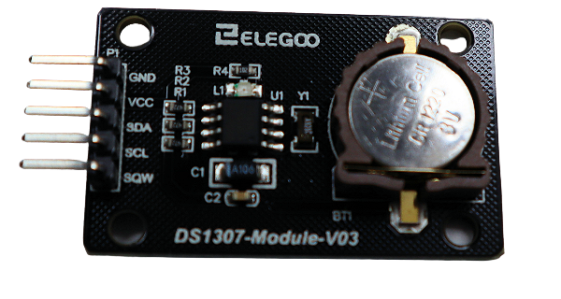
DS1307
DS1307 is a serial real time clock module.
The sensor has 5 pins: VCC for power supply (5v); Gnd for mass; SDA: I2C Serial Data; SCL: I2C Serial Clock; SQW:Square Wave/Output Driver (unused for our purposes).
The sensor allows us to count the time that passes in order to act accordingly.

Slide 7
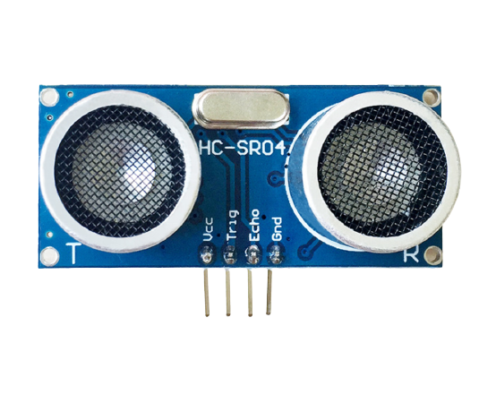
HC-SR04
HC-SR04 is an ultrasonic sensor.
The sensor has 4 pins: VCC for power supply (5v); Gnd for mass; Trig: pin that starts ultrasonic pulses; Echo: pin that defines the elapsed time.
The sensor allows you to measure the distance from an obstacle. When the micro-controller sets the Pin Trigger to 1, the sensor sends 8 ultrasonic pulses. When these are then received, the sensor sets to 1 the Echo pin, is then measured the time that passes between the activation of the Trigger pin and the setting of the Echo pin. Finally, note the speed of sound, convert the measured time into a length and then derive the distance of the obstacle.

Slide 8
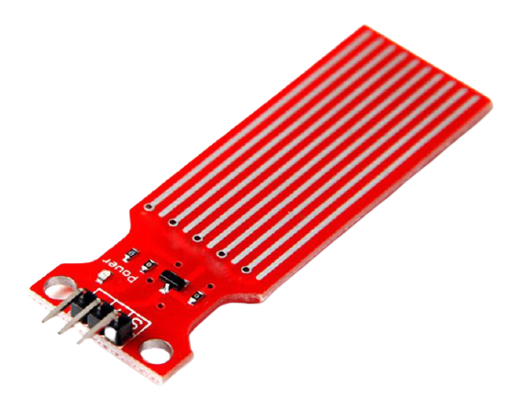
WATER LEVEL DETECTION SENSOR MODULE
Water Level Sensor is a sensor to detect water.
The sensor has 3 pins: + for power supply (5v); - for mass; S: the analog input pin.
This sensor is designed for water detection, which can be widely used in sensing rainfall, water level, and even liquid leakage. The sensor has an array of exposed traces, which read LOW when water is detected.

Slide 9
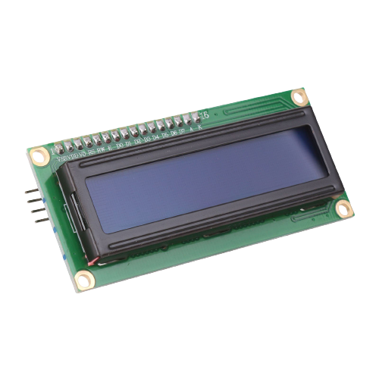
LCD 16X2 DISPLAY
The LCD 16x2 is a lcd display with an I2c adapter.
The adapter has 4 pins: VCC for power supply (5v); Gnd for mass; SDA: I2C Serial Data; SCL: I2C Serial Clock.
The display allows you to show characters on video, through which you can compose service messages.

Slide 10
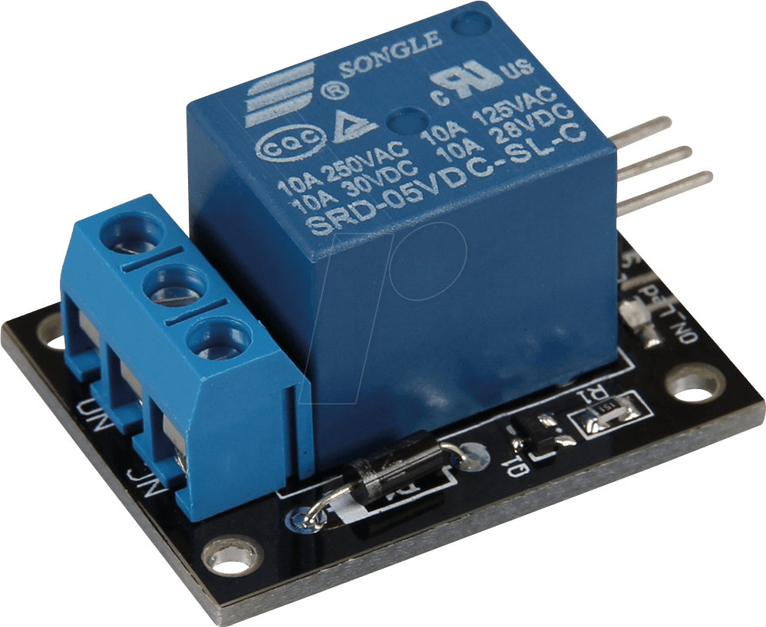
RELAY MODULE
The Relay Module is an electrically operated device.
The Relay has 6 pins: Middle Pin for power supply (5v); Gnd for mass; S: Digital Signal ; NC: Normally Closed ; NO: Normally Open; Common.
The relay allows us to control through a digital signal a device that requires excessive power supply.

Slide 11
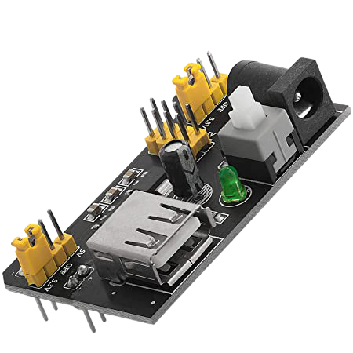
POWER SUPPLY MODULE
The Power Supply Module is a component that delivers voltage.
The power supply has several pins from which various devices can be powered.
The power supply is able to deliver different voltage levels (3.3 and 5 volts) given an input power supply.

Slide 12
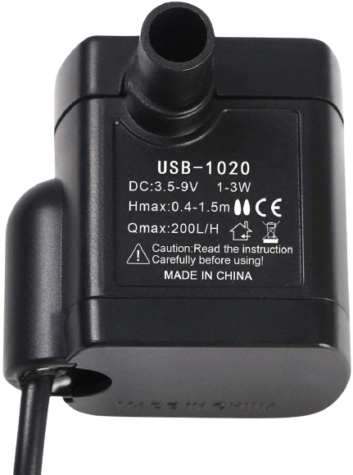
WATER PUMP
The Water Pump is a component that delivers voltage.
The water pump is the component that requires the use of the power supply module. It takes care of physically irrigating the plant.

Slide 13
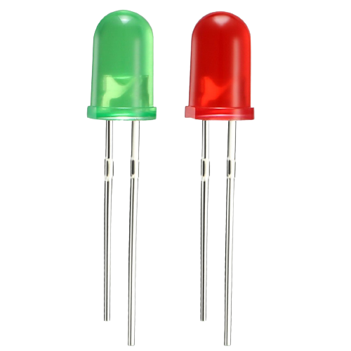
LED
A led is a emitting light device.
The green LED indicates irrigation in progress, while the red LED indicates the need to supply the water container.

Slide 14
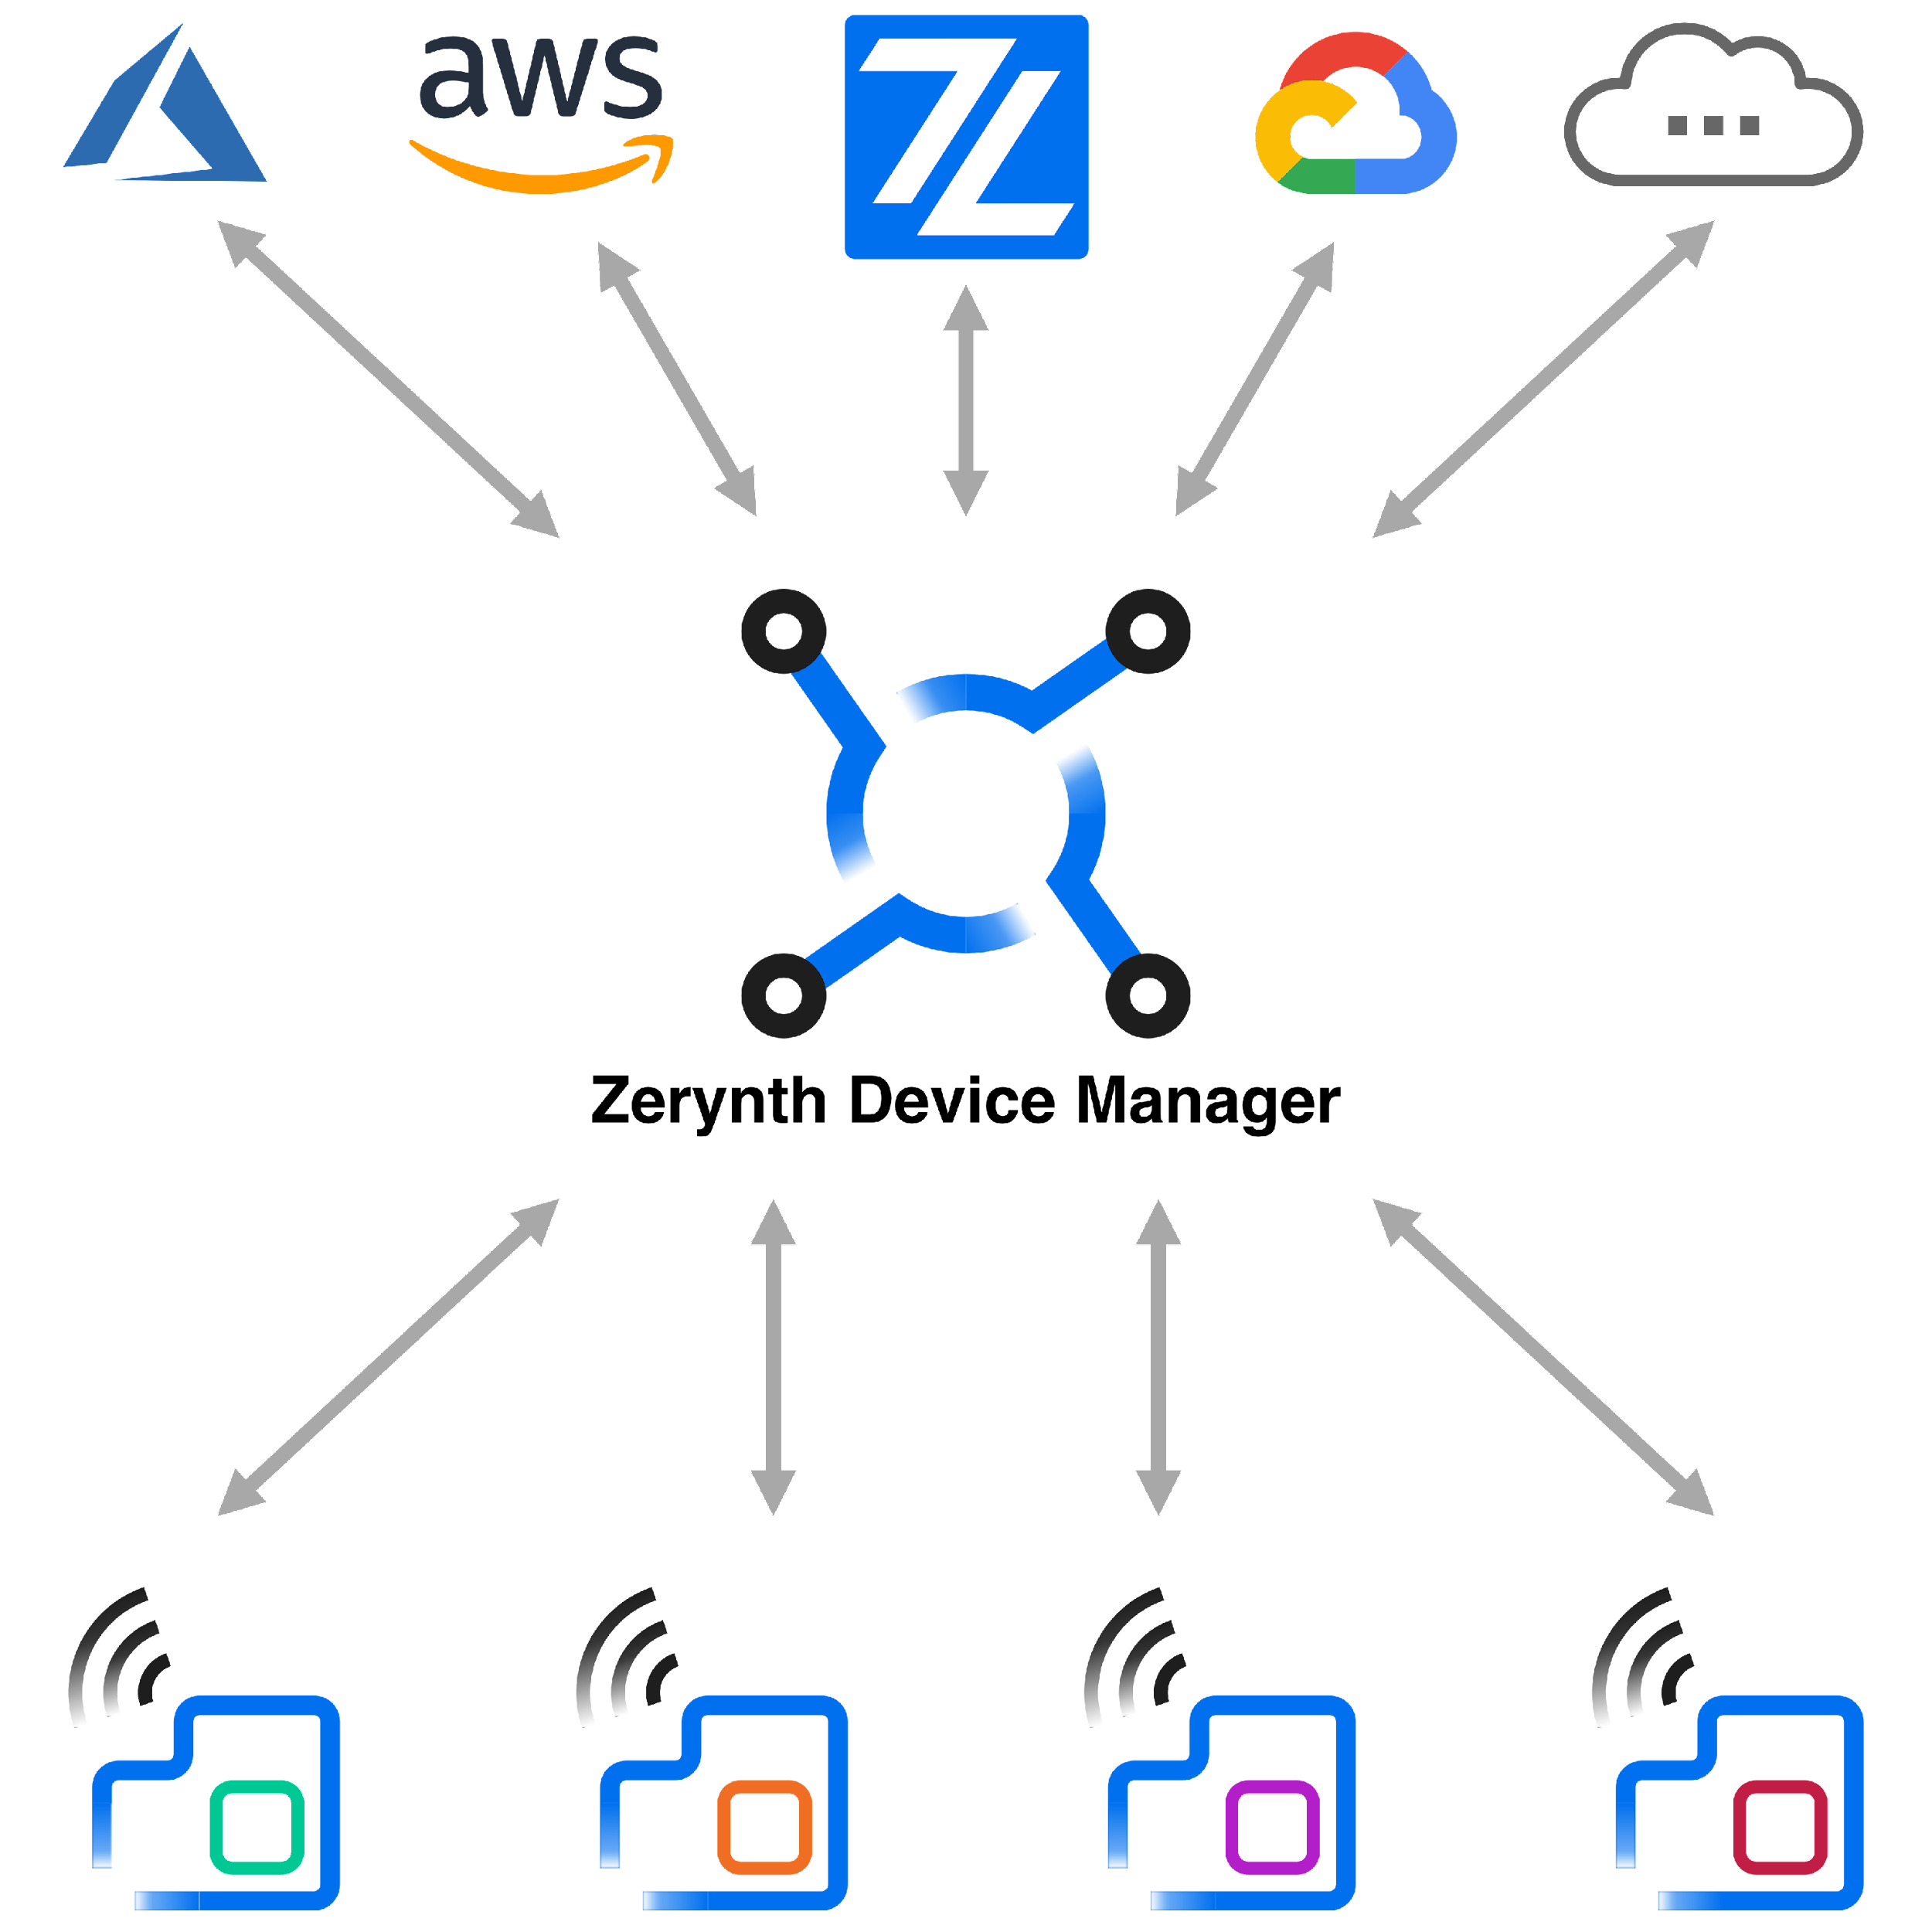
ZERYNTH ZDM
Zerynth Device Manager (ZDM) is a device and data management service that makes it easy to securely register, organize, monitor, and remotely manage IoT devices at scale. ZDM allows the management of devices and also collects and aggregates the data produced. ZDM integrates with all primary cloud service providers allowing you to easily connect devices to the cloud and other devices so you can remotely control your fleet.

Slide 15

GRAFANA
Grafana is a web application for interactive data visualization and analysis. Grafana allows you to view infographics and alarms for the web, unifying various data sources. The data can be displayed on special panels (dashboards). The creation of these panels can be done through interactive query builders. Support for some sources is included by default such as Elasticsearch, Mysql and Prometheus. Other technologies can be integrated with add-ons such as Gitlab, Jira, Postgresql, Solr and Zabbix.

Slide 16
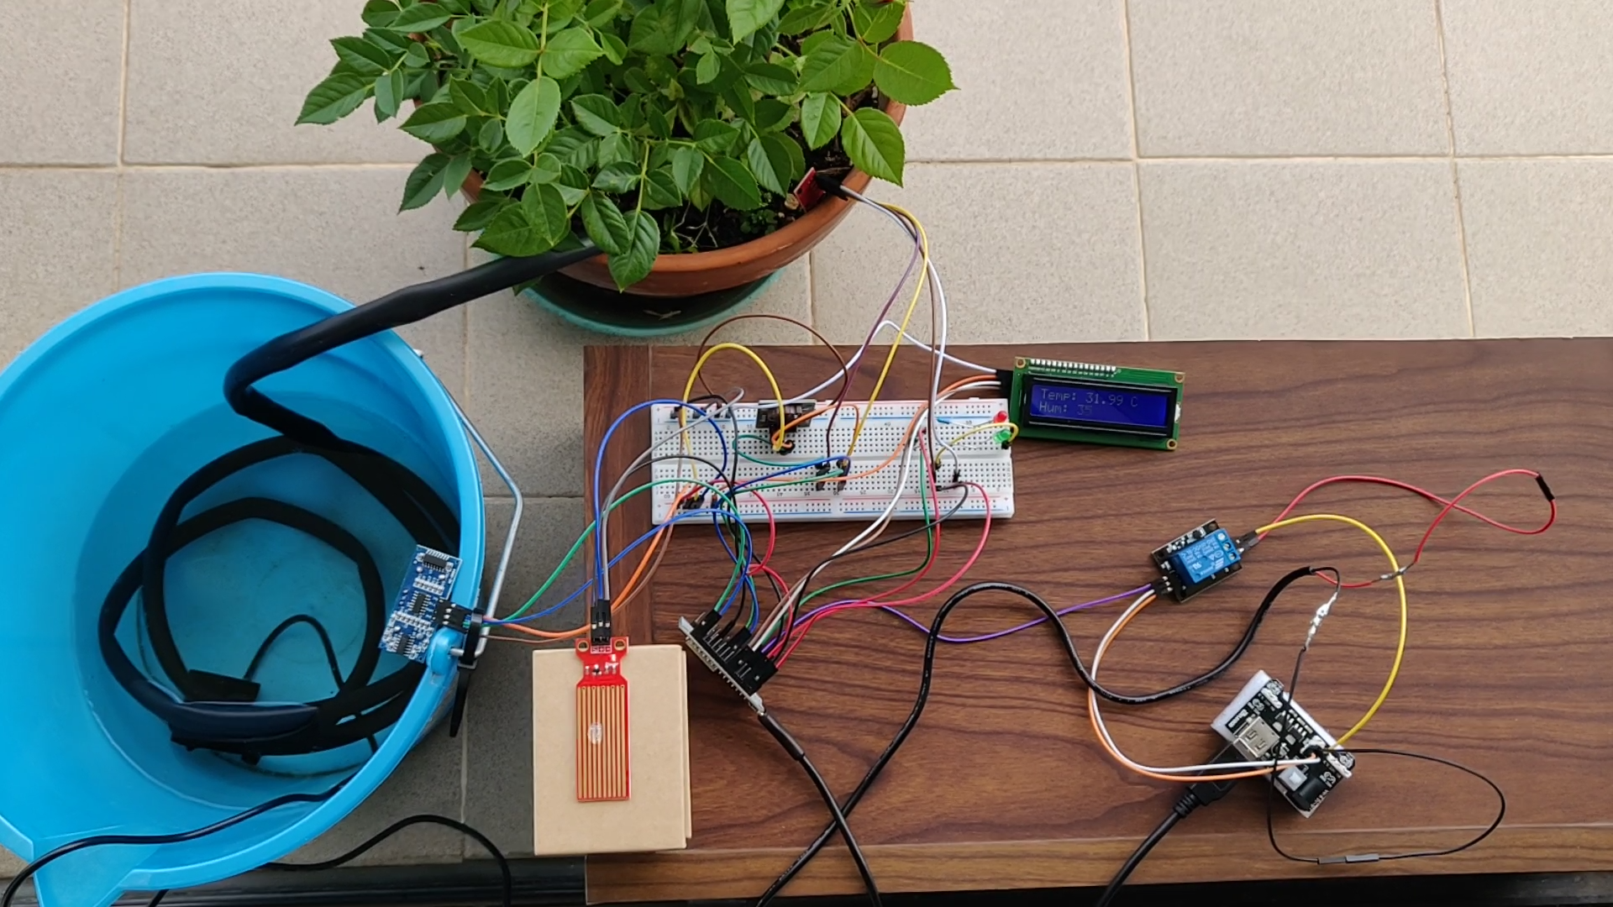
IRRIGAZIONE PIANTA

